Slide 1
Processing Unit

Slide 2
Overview
Instruction Set Processor (ISP)
Central Processing Unit (CPU)
A typical computing task consists of a series of steps specified by a sequence of machine instructions that constitute a program.
An instruction is executed by carrying out a sequence of more rudimentary operations.

Slide 3
Some Fundamental Concepts

Slide 4
Fundamental Concepts
Processor fetches one instruction at a time and perform the operation specified.
Instructions are fetched from successive memory locations until a branch or a jump instruction is encountered.
Processor keeps track of the address of the memory location containing the next instruction to be fetched using Program Counter (PC).
Instruction Register (IR)

Slide 5
Executing an Instruction
Fetch the contents of the memory location pointed to by the PC. The contents of this location are loaded into the IR (fetch phase).
IR ← [[PC]]
Assuming that the memory is byte addressable, increment the contents of the PC by 4 (fetch phase).
PC ← [PC] + 4
Carry out the actions specified by the instruction in the IR (execution phase).

Slide 6
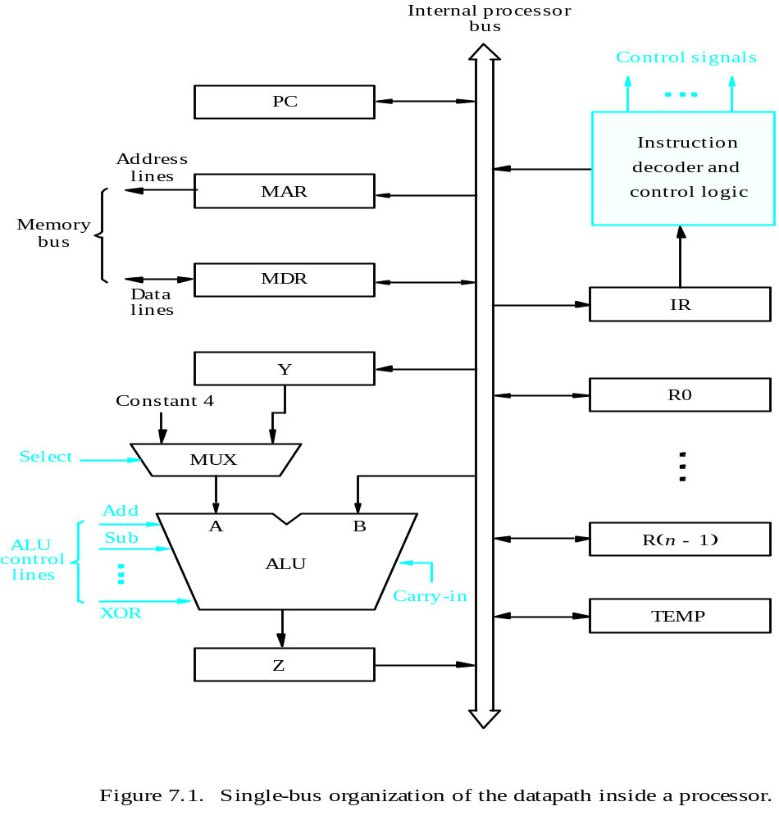
Processor Organization
MDR HAS TWO INPUTS AND TWO OUTPUTS
Datapath

Slide 7
Executing an Instruction
Transfer a word of data from one processor register to another or to the ALU.
Perform an arithmetic or a logic operation and store the result in a processor register.
Fetch the contents of a given memory location and load them into a processor register.
Store a word of data from a processor register into a given memory location.

Slide 8
Register Transfers
Internal processor
b
us
R
i
in
R
i
R
i
out
Y
in
Y
Constant 4
Select
MUX
A
B
ALU
Z
in
Z
Z
out
Figure 7.2. Input and output gating for the registers in Figure 7.1.

Slide 9
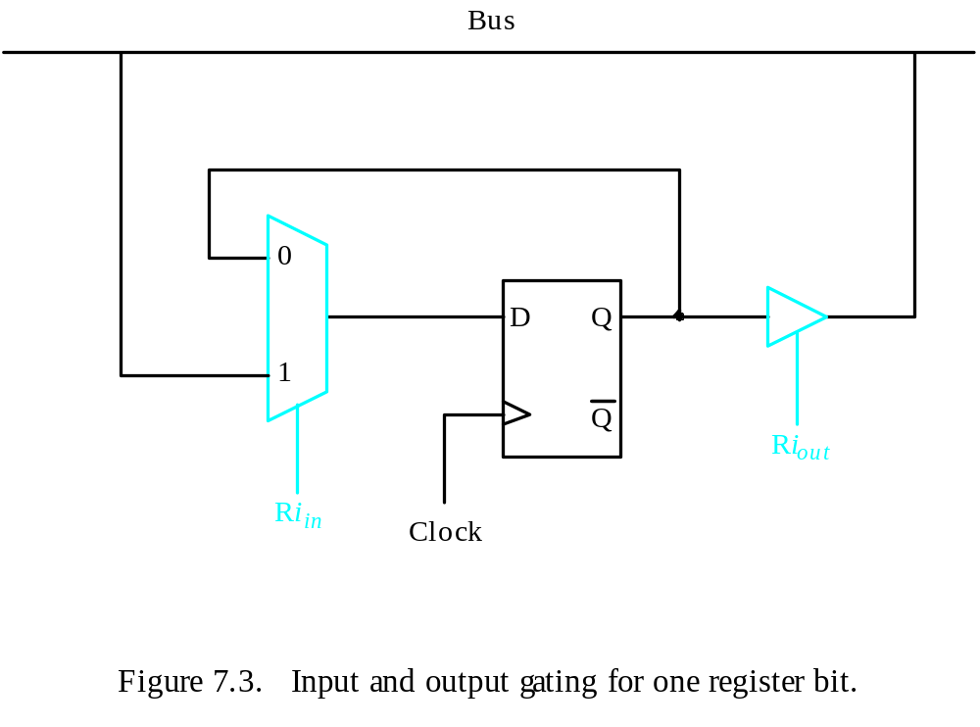
Register Transfers
All operations and data transfers are controlled by the processor clock.
Figure 7.3. Input and output gating for one register bit.

Slide 10
Performing an Arithmetic or Logic Operation
The ALU is a combinational circuit that has no internal storage.
ALU gets the two operands from MUX and bus. The result is temporarily stored in register Z.
What is the sequence of operations to add the contents of register R1 to those of R2 and store the result in R3?
  R1out, Yin
  R2out, SelectY, Add, Zin
  Zout, R3in

Slide 11
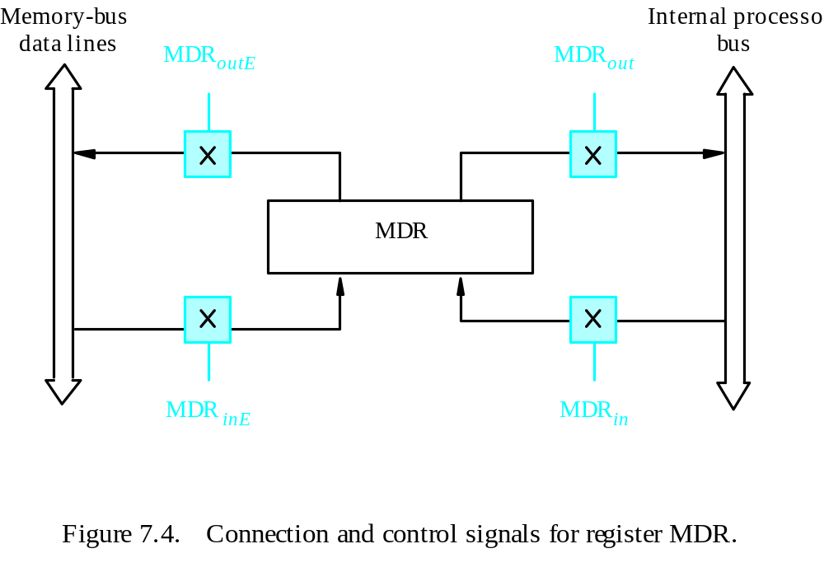
Fetching a Word from Memory
Address into MAR; issue Read operation; data into MDR.
Figure 7.4. Connection and control signals for register MDR.

Slide 12
Fetching a Word from Memory
The response time of each memory access varies (cache miss, memory-mapped I/O,…).
To accommodate this, the processor waits until it receives an indication that the requested operation has been completed (Memory-Function-Completed, MFC).
Move (R1), R2
MAR ← [R1]
Start a Read operation on the memory bus
Wait for the MFC response from the memory
Load MDR from the memory bus
R2 ← [MDR]

Slide 13
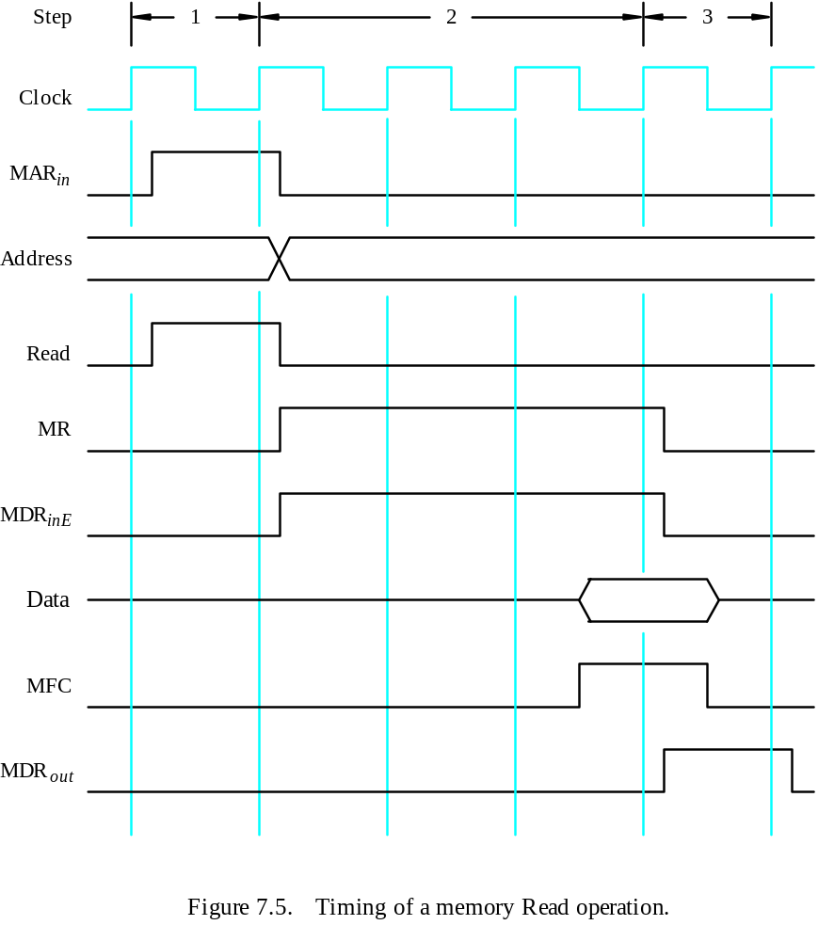
Timing
MAR ← [R1]
Assume MAR
is always available
on the address lines
of the memory bus.
Start a Read operation on the memory bus
Wait for the MFC response from the memory
Load MDR from the memory bus
R2 ← [MDR]

Slide 14
Execution of a Complete Instruction
Add (R3), R1
Fetch the instruction
Fetch the first operand (the contents of the memory location pointed to by R3)
Perform the addition
Load the result into R1

Slide 15
Architecture
Internal processor
b
us
R
i
in
R
i
R
i
out
Y
in
Y
Constant 4
Select
MUX
A
B
ALU
Z
in
Z
Z
out
Figure 7.2. Input and output gating for the registers in Figure 7.1.

Slide 16
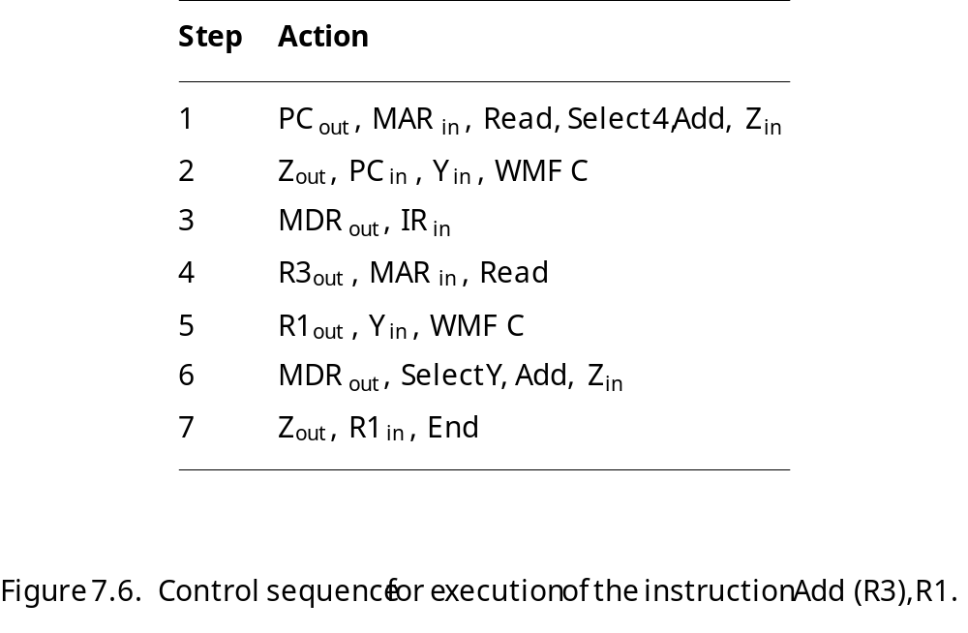
Execution of a Complete Instruction
Add (R3), R1

Slide 17
Execution of Branch Instructions
A branch instruction replaces the contents of PC with the branch target address, which is usually obtained by adding an offset X given in the branch instruction.
The offset X is usually the difference between the branch target address and the address immediately following the branch instruction.
Conditional branch

Slide 18
Execution of Branch Instructions
Step
Action
1
PC
out
,
MAR
in
,
Read,
Select4,
Add,
Z
in
2
Z
out
,
PC
in
,
Y
in
,
WMF
C
3
MDR
out
,
IR
in
4
Offset-field-of-IR
out
,
Add,
Z
in
5
Z
out
,
PC
in
,
End
Figure 7.7. Control sequence for an unconditional branch instruction.

Slide 19
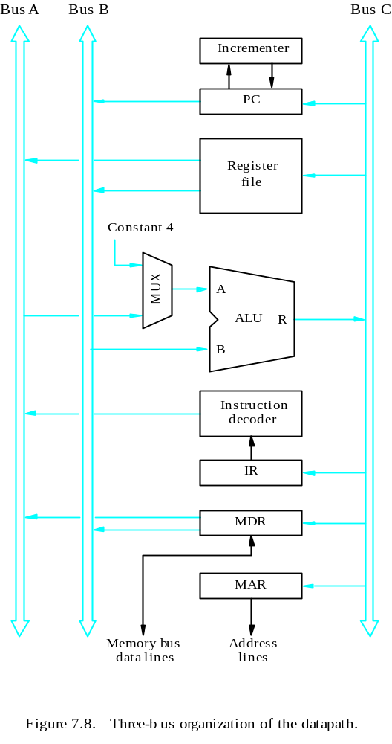
Multiple-Bus Organization

Slide 20
Multiple-Bus Organization
Add R4, R5, R6
Step
Action
1
PC
out
,
R=B,
MAR
in
,
Read,
IncPC
2
WMF
C
3
MDR
outB
,
R=B,
IR
in
4
R4
outA
,
R5
outB
,
SelectA,
Add,
R6
in
,
End
Figure 7.9. Control sequence for the instruction. Add R4,R5,R6,
for the three-bus organization in Figure 7.8.

Slide 21
How Does a Machine Process Instructions?
What does processing an instruction mean?
Remember the von Neumann model
AS = Architectural (programmer visible) state before an instruction is processed
Process instruction
AS’ = Architectural (programmer visible) state after an instruction is processed
Processing an instruction: Transforming AS to AS’ according to the ISA specification of the instruction
21 to 39 taken from 18-447 introduction to computer architecture

Slide 22
The “Process instruction” Step
ISA specifies abstractly what AS’ should be, given an instruction and AS
  It defines an abstract finite state machine where
    State = programmer-visible state
    Next-state logic = instruction execution specification
  From ISA point of view, there are no “intermediate states” between AS and AS’ during instruction execution
    One state transition per instruction
Microarchitecture implements how AS is transformed to AS’
  There are many choices in implementation
  We can have programmer-invisible state to optimize the speed of instruction execution: multiple state transitions per instruction
    Choice 1: AS → AS’ (transform AS to AS’ in a single clock cycle)
    Choice 2: AS → AS+MS1 → AS+MS2 → AS+MS3 → AS’ (take multiple clock cycles to transform AS to AS’)

Slide 23
A Very Basic Instruction Processing Engine
Each instruction takes a single clock cycle to execute
Only combinational logic is used to implement instruction execution
  No intermediate, programmer-invisible state updates
AS = Architectural (programmer visible) state
at the beginning of a clock cycle
Process instruction in one clock cycle
AS’ = Architectural (programmer visible) state
at the end of a clock cycle
21 to 39 taken from 18-447 introduction to computer architecture

Slide 24
A Very Basic Instruction Processing Engine
Single-cycle machine
What is the clock cycle time determined by?
What is the critical path of the combinational logic determined by?
AS’
AS
Sequential
Logic
(State)
Combinational
Logic
21 to 39 taken from 18-447 introduction to computer architecture

Slide 25
Remember: Programmer Visible (Architectural) State
M[0]
M[1]
M[2]
M[3]
Registers
- given special names in the ISA
(as opposed to addresses)
- general vs. special purpose
M[4]
M[N-1]
Memory
array of storage locations
indexed by an address
Program Counter
memory address
of the current instruction
Instructions (and programs) specify how to transform
the values of programmer visible state
21 to 39 taken from 18-447 introduction to computer architecture

Slide 26
Single-cycle vs. Multi-cycle Machines
Single-cycle machines
  Each instruction takes a single clock cycle
  All state updates made at the end of an instruction’s execution
  Big disadvantage: The slowest instruction determines cycle time → long clock cycle time
Multi-cycle machines
  Instruction processing broken into multiple cycles/stages
  State updates can be made during an instruction’s execution
  Architectural state updates made only at the end of an instruction’s execution
  Advantage over single-cycle: The slowest “stage” determines cycle time
  Both single-cycle and multi-cycle machines literally follow the von Neumann model at the microarchitecture level

Slide 27
Instruction Processing “Cycle”
Instructions are processed under the direction of a “control unit” step by step.
Instruction cycle: Sequence of steps to process an instruction
Fundamentally, there are six phases:
Fetch
Decode
Evaluate Address
Fetch Operands
Execute
Store Result
Not all instructions require all six stages (see P&P Ch. 4)

Slide 28
Instruction Processing “Cycle” vs. Machine Clock Cycle
Single-cycle machine:
  All six phases of the instruction processing cycle take a single machine clock cycle to complete
Multi-cycle machine:
  All six phases of the instruction processing cycle can take multiple machine clock cycles to complete
  In fact, each phase can take multiple clock cycles to complete

Slide 29
Instruction Processing Viewed Another Way
Instructions transform Data (AS) to Data’ (AS’)
This transformation is done by functional units
  Units that “operate” on data
These units need to be told what to do to the data
An instruction processing engine consists of two components
  Datapath: Consists of hardware elements that deal with and transform data signals
    functional units that operate on data
    hardware structures (e.g. wires and muxes) that enable the flow of data into the functional units and registers
    storage units that store data (e.g., registers)
  Control logic: Consists of hardware elements that determine control signals, i.e., signals that specify what the datapath elements should do to the data

Slide 30
Single-cycle vs. Multi-cycle: Control & Data
Single-cycle machine:
  Control signals are generated in the same clock cycle as the one during which data signals are operated on
  Everything related to an instruction happens in one clock cycle (serialized processing)
Multi-cycle machine:
  Control signals needed in the next cycle can be generated in the current cycle
  Latency of control processing can be overlapped with latency of datapath operation (more parallelism)

Slide 31
Many Ways of Datapath and Control Design
There are many ways of designing the data path and control logic
Single-cycle, multi-cycle, pipelined datapath and control
Hardwired/combinational vs. microcoded/microprogrammed control
  Control signals generated by combinational logic versus
  Control signals stored in a memory structure
Control signals and structure depend on the datapath design

Slide 32
Remember…
Single-cycle machine
AS’
AS
Sequential
Logic
(State)
Combinational
Logic
21 to 39 taken from 18-447 introduction to computer architecture

Slide 33
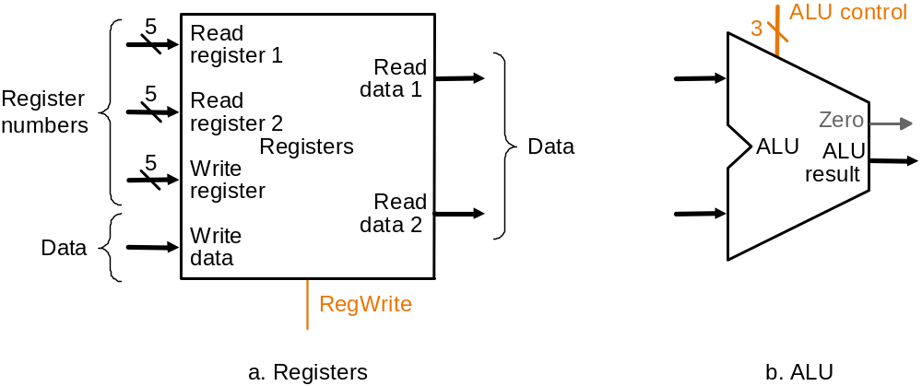
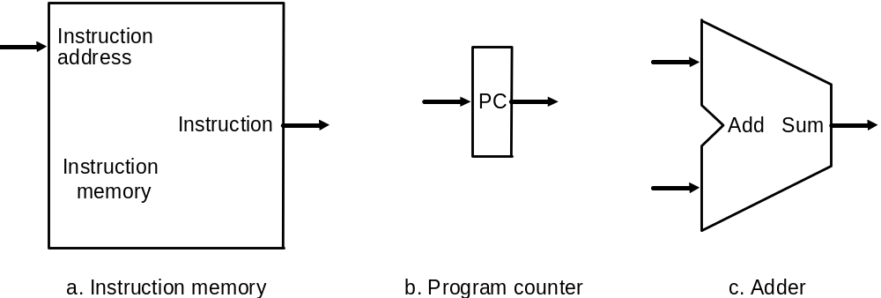
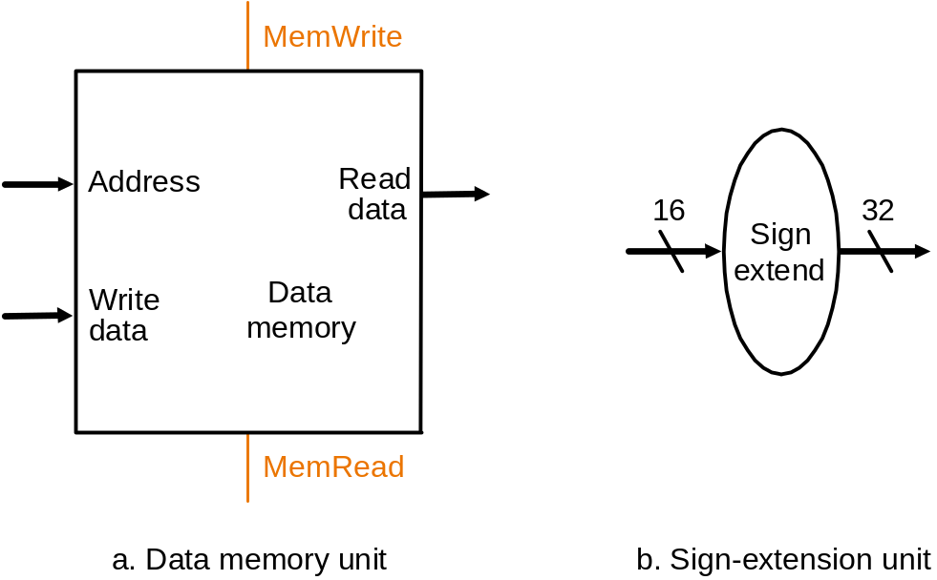
Let’s Start with the State Elements
Data and control inputs
**Based on original figure from [P&H CO&D, COPYRIGHT 2004 Elsevier. ALL RIGHTS RESERVED.]

Slide 34
For Now, We Will Assume
“Magic” memory and register file
Combinational read
  output of the read data port is a combinational function of the register file contents and the corresponding read select port
Synchronous write
  the selected register is updated on the positive edge clock transition when write enable is asserted
    Cannot affect read output in between clock edges
Single-cycle, synchronous memory
  Contrast this with memory that tells when the data is ready
  i.e., Ready bit: indicating the read or write is done

Slide 35
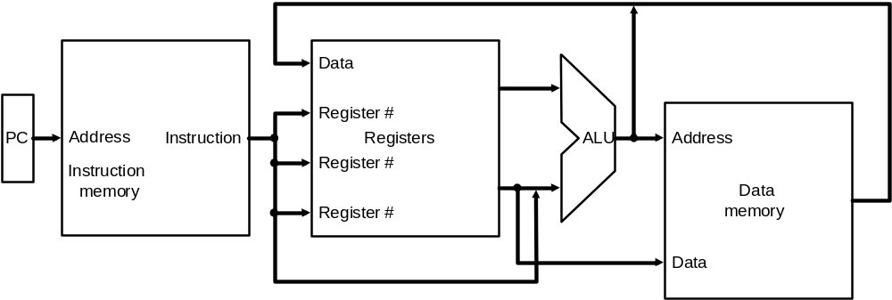
Instruction Processing
5 generic steps (P&H book)
  Instruction fetch (IF)
  Instruction decode and register operand fetch (ID/RF)
  Execute/Evaluate memory address (EX/AG)
  Memory operand fetch (MEM)
  Store/writeback result (WB)
WB
IF
ID/RF
EX/AG
MEM
**Based on original figure from [P&H CO&D, COPYRIGHT 2004 Elsevier. ALL RIGHTS RESERVED.]

Slide 36
Single-Cycle Datapath for
Arithmetic and Logical Instructions

Slide 37
R-Type ALU Instructions
Assembly (e.g., register-register signed addition)
ADD rd_{reg} rs_{reg} rt_{reg}
Machine encoding
Semantics
if MEM[PC] == ADD rd rs rt
  GPR[rd] ← GPR[rs] + GPR[rt]
  PC ← PC + 4
0
6-bit
rs
5-bit
rt
5-bit
rd
5-bit
0
5-bit
ADD
6-bit
R-type

Slide 38

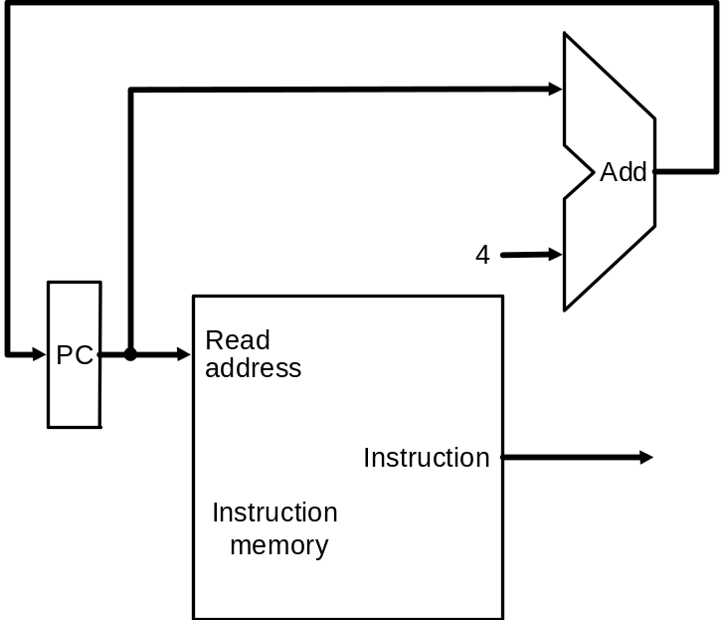
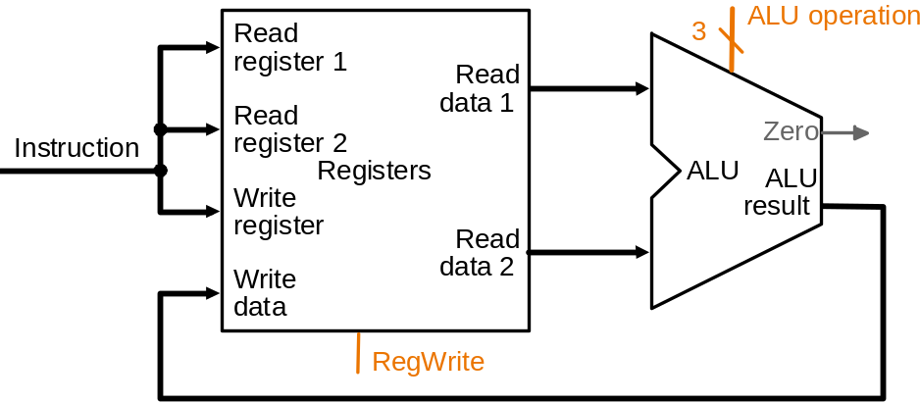
ALU Datapath
25:21
20:16
15:11
1
IF
ID
EX
MEM
WB
if MEM[PC] == ADD rd rs rt
  GPR[rd] ← GPR[rs] + GPR[rt]
  PC ← PC + 4
Combinational
state update logic
**Based on original figure from [P&H CO&D, COPYRIGHT 2004 Elsevier. ALL RIGHTS RESERVED.]
**Based on original figure from [P&H CO&D, COPYRIGHT 2004 Elsevier. ALL RIGHTS RESERVED.]

Slide 39
I-Type ALU Instructions
Assembly (e.g., register-immediate signed additions)
ADDI rt_{reg} rs_{reg} immediate₁₆
Machine encoding
Semantics
if MEM[PC] == ADDI rt rs immediate
GPR[rt] ← GPR[rs] + sign-extend (immediate)
PC ← PC + 4
I-type
ADDI
6-bit
rs
5-bit
rt
5-bit
immediate
16-bit

Slide 40
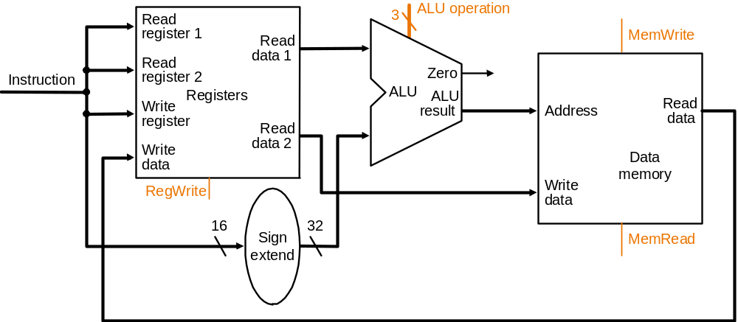
Datapath for R and I-Type ALU Insts.
25:21
20:16
15:11
RegDest
isItype
1
ALUSrc
isItype
IF
ID
EX
MEM
WB
if MEM[PC] == ADDI rt rs immediate
  GPR[rt] ← GPR[rs] + sign-extend (immediate)
  PC ← PC + 4
Combinational
state update logic
**Based on original figure from [P&H CO&D, COPYRIGHT 2004 Elsevier. ALL RIGHTS RESERVED.]
21 to 39 taken from 18-447 introduction to computer architecture

Slide 41
What is the control sequence for execution of the instruction
Add R1, R2
including the instruction fetch phase? (Assume single bus architecture)

Slide 42
Hardwired Control

Slide 43
Overview
To execute instructions, the processor must have some means of generating the control signals needed in the proper sequence.
Two categories: hardwired control and microprogrammed control
Hardwired system can operate at high speed; but with little flexibility.

Slide 44
Control Unit Organization
Clock
CLK
Control step
counter
External
inputs
Decoder/
IR
encoder
Condition
codes
Control signals
Figure 7.10. Control unit organization.

Slide 45
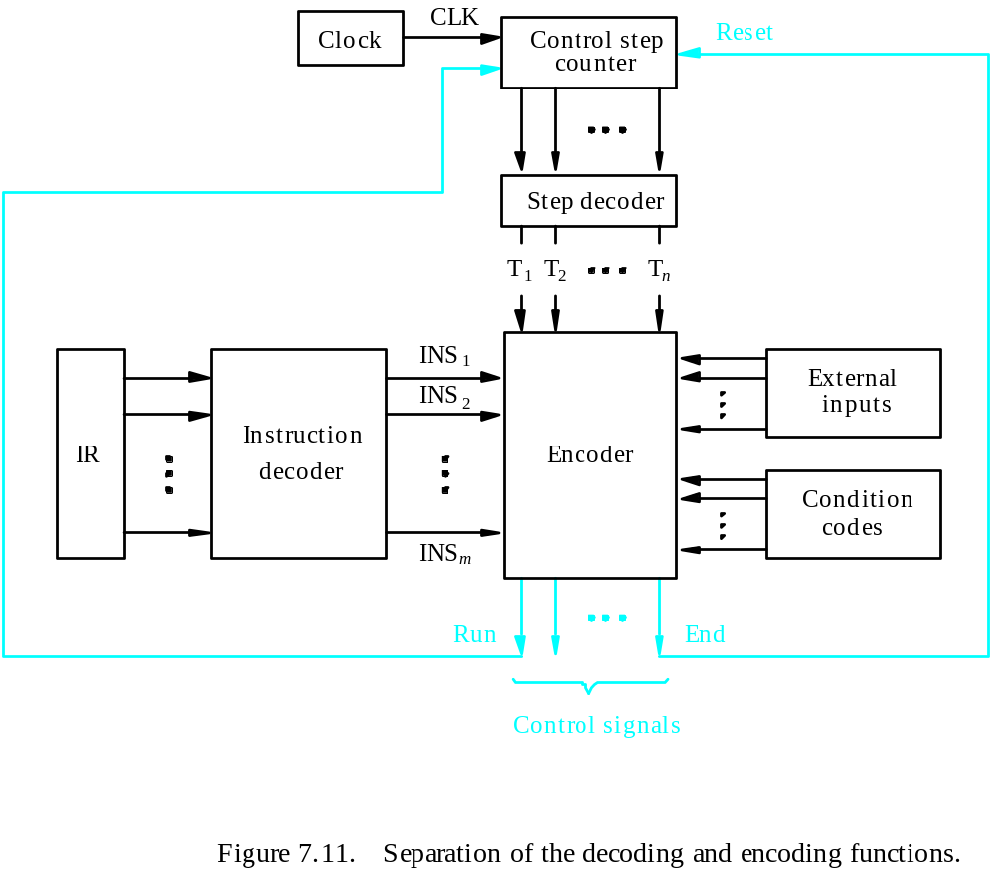
Detailed Block Description

Slide 46
Generating Z_{in}
Z_{in} = T₁ + T₆ • ADD + T₄ • BR + …
Branch
Add
T
4
T
6
T
1
Figure 7.12. Generation of the Z_{in} control signal for the processor in Figure 7.1.

Slide 47
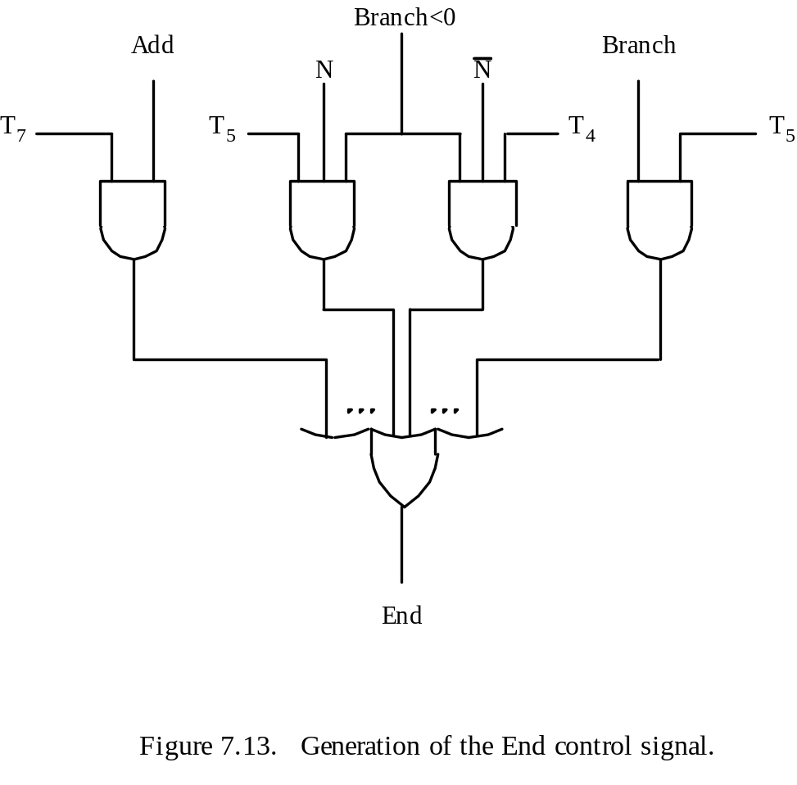
Generating End
End = T₇ • ADD + T₅ • BR + (T₅ • N + T₄ • N) • BRN +…

Slide 48
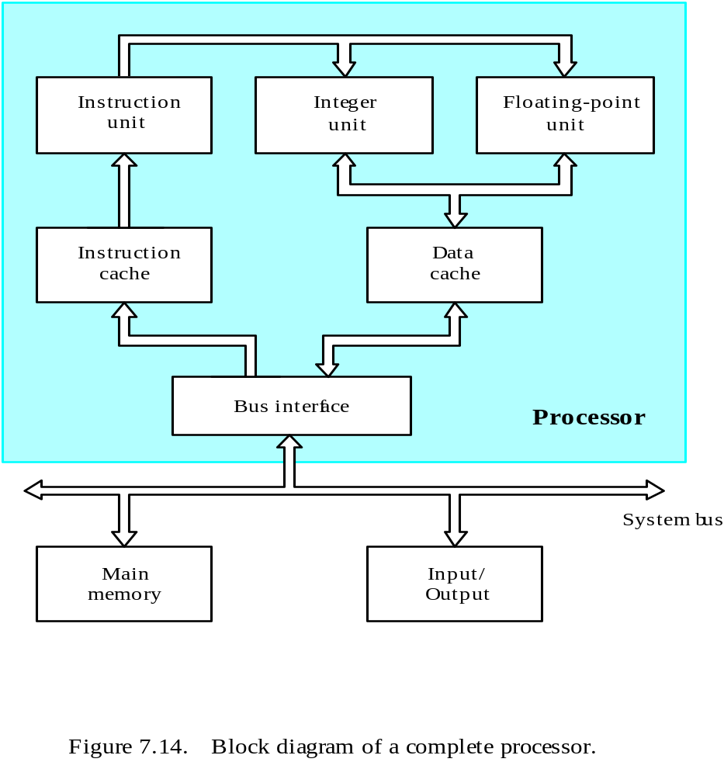
A Complete Processor

Slide 49
Microprogrammed Control

Slide 50
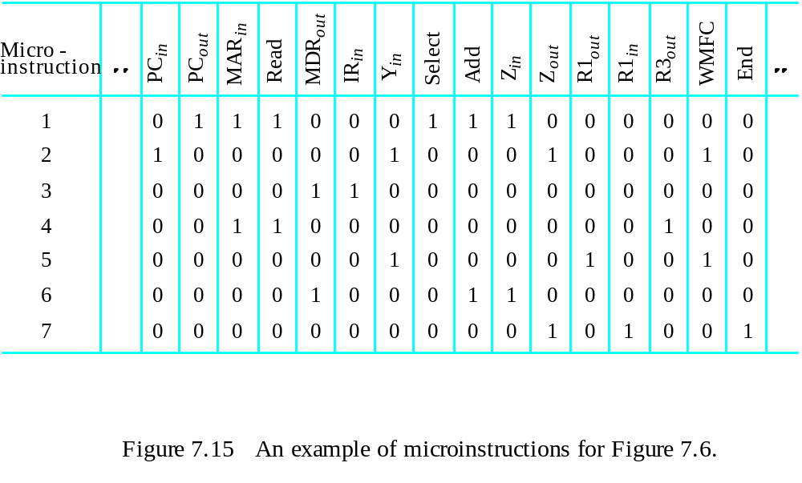
Overview
Control signals are generated by a program similar to machine language programs.
Control Word (CW); microroutine; microinstruction

Slide 51
Overview

Slide 52
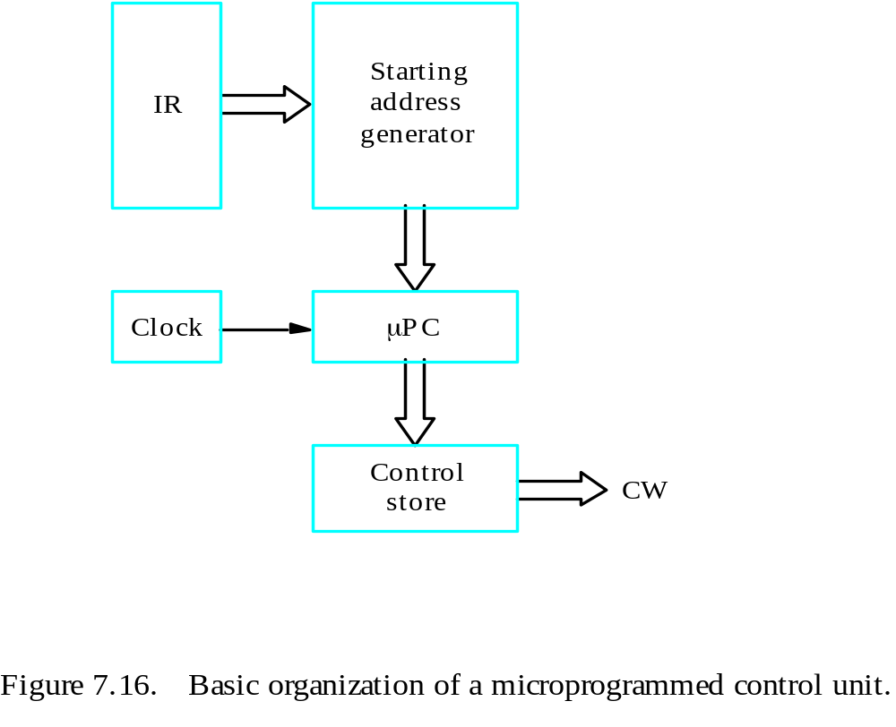
Overview
Control store
One function
cannot be carried
out by this simple
organization.

Slide 53
Overview
The previous organization cannot handle the situation when the control unit is required to check the status of the condition codes or external inputs to choose between alternative courses of action.
Use conditional branch microinstruction.
Address
Microinstruction
0
PC
out
,
MAR
in
,
Read,
Select4,
Add,
Z
in
1
Z
out
,
PC
in
,
Y
in
,
WMF
C
2
MDR
out
,
IR
in
3
Branch
to
starting
address
of
appropriate
microroutine
.
.
.
.
.
.
.
.
.
.
.
.
.
.
.
.
.
.
.
.
.
.
.
.
.
.
.
.
.
.
.
.
.
.
.
.
.
.
.
.
.
.
.
.
.
.
.
.
.
.
.
.
.
.
.
.
.
.
.
.
.
.
.
.
.
.
25
If
N=0,
then
branch
to
microinstruction
0
26
Offset-field-of-IR
out
,
SelectY,
Add,
Z
in
27
Z
out
,
PC
in
,
End
Figure 7.17. Microroutine for the instruction Branch<0.

Slide 54
Overview
External
inputs
Starting and
Condition
IR
branch address
codes
generator
Clock
μ
P
C
Control
CW
store
Figure 7.18. Organization of the control unit to allow
conditional branching in the microprogram.

Slide 55
Microinstructions
A straightforward way to structure microinstructions is to assign one bit position to each control signal.
However, this is very inefficient.

Slide 56
How many control signals are required, if there are 8 registers?

Slide 57
The length can be reduced: most signals are not needed simultaneously, and many signals are mutually exclusive.
All mutually exclusive signals are placed in the same group in binary coding.

Slide 58
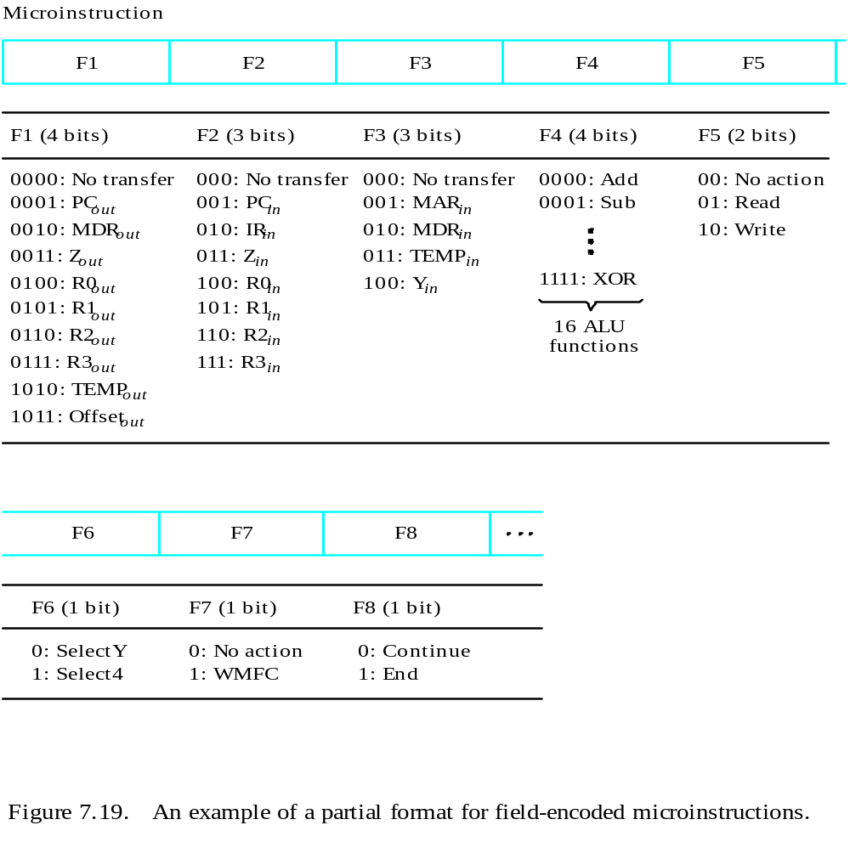
Partial Format for the Microinstructions
What is the price paid for
this scheme?

Slide 59
Further Improvement
Enumerate the patterns of required signals in all possible microinstructions. Each meaningful combination of active control signals can then be assigned a distinct code.
Vertical organization
Horizontal organization

Slide 60
Microprogram Sequencing
If all microprograms require only straightforward sequential execution of microinstructions except for branches, letting a μPC governs the sequencing would be efficient.
However, two disadvantages:
Having a separate microroutine for each machine instruction results in a large total number of microinstructions and a large control store.
Longer execution time because it takes more time to carry out the required branches.
Example: Add src, Rdst
Four addressing modes: register(00), auto-increment (01), auto-decrement (10), and indexed(11) (with indirect forms).

Slide 61
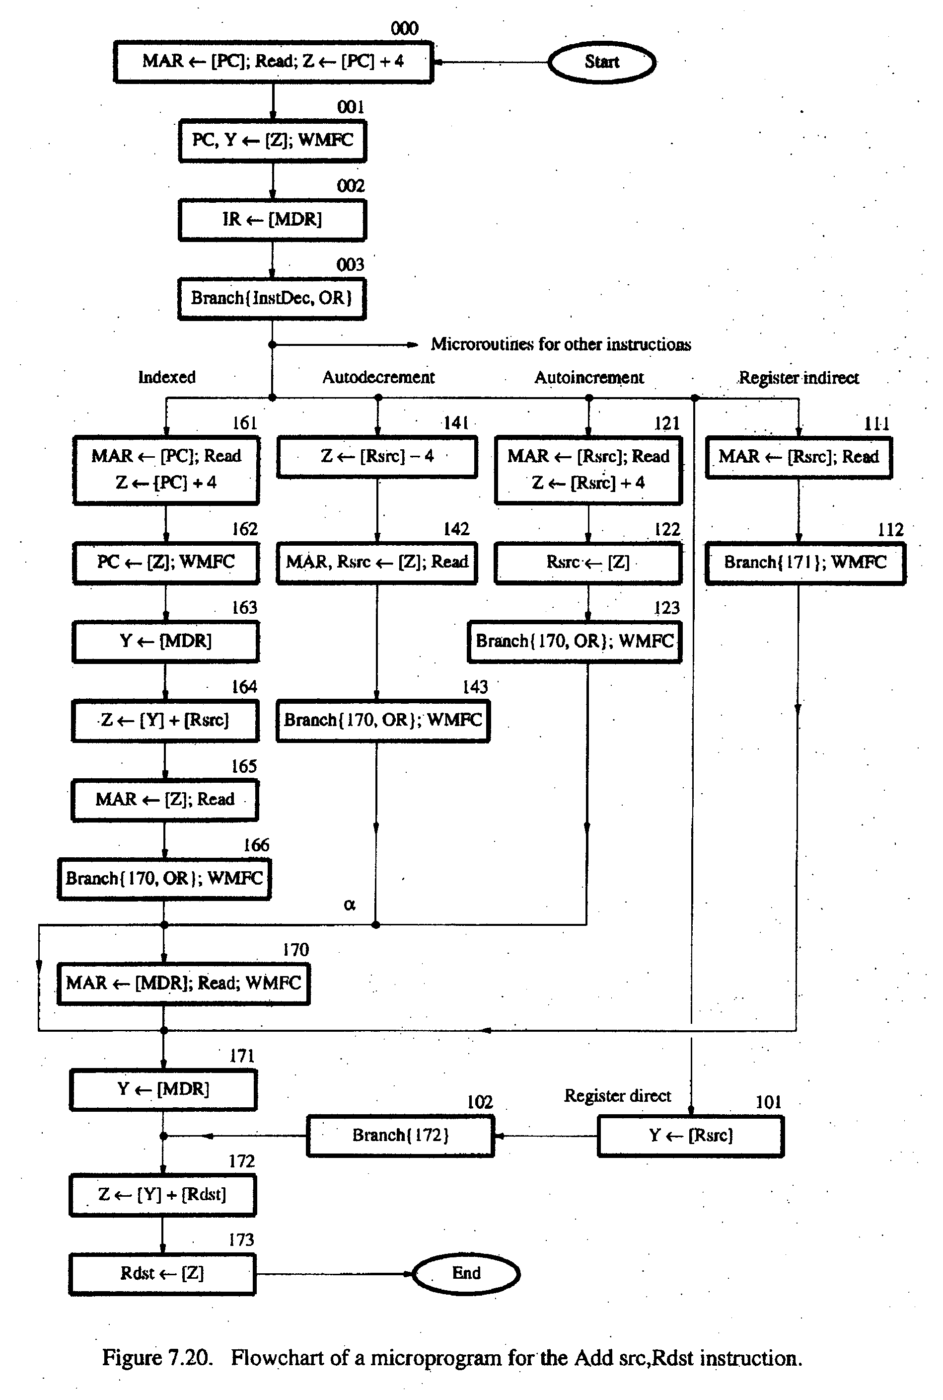
- Bit-ORing
- Wide-Branch Addressing
- WMFC

Slide 62
Mode
Contents of IR
OP code
0
1
0
Rsrc
Rdst
11
10
8
7
4
3
0
Address
Microinstruction
(octal)
000
PC
, MAR
, Read, Select
, Add, Z
out
in
4
in
001
Z
out
, PC
in
, Y
in
, WMFC
002
MDR
out
, IR
in
003
μ
Branch {
μ
PC
←
101 (from Instruction decoder);
μ
PC
5,4
←
[IR
10,9
];
μ
PC
3
←
[IR
10
]
⋅
[IR
9
]
⋅
[IR
8
]}
121
Rsrc
, MAR
, Read, Select4, Add, Z
out
in
in
122
Z
out
, Rsrc
in
123
μ
Branch {
μ
PC
←
170;
μ
PC
0
←
[IR
8
]}, WMFC
170
MDR
out
, MAR
in
, Read, WMFC
171
MDR
out
, Y
in
172
Rdst
out
, SelectY
, Add, Z
in
173
Z
out
, Rdst
in
, End
Figure 7.21.
Microinstruction for Add (Rsrc)+,Rdst.
Note:
Microinstruction at location 170 is not executed for this addressing mode.

Slide 63
Microinstructions with Next-Address Field
The microprogram we discussed requires several branch microinstructions, which perform no useful operation in the datapath.
A powerful alternative approach is to include an address field as a part of every microinstruction to indicate the location of the next microinstruction to be fetched.
Pros: separate branch microinstructions are virtually eliminated; few limitations in assigning addresses to microinstructions.
Cons: additional bits for the address field (around 1/6)

Slide 64
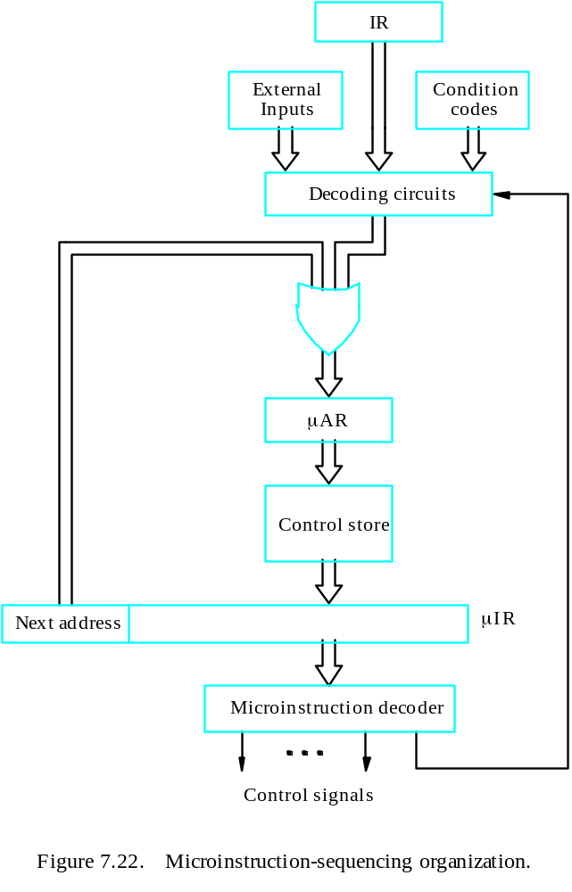
Microinstructions with Next-Address Field

Slide 65
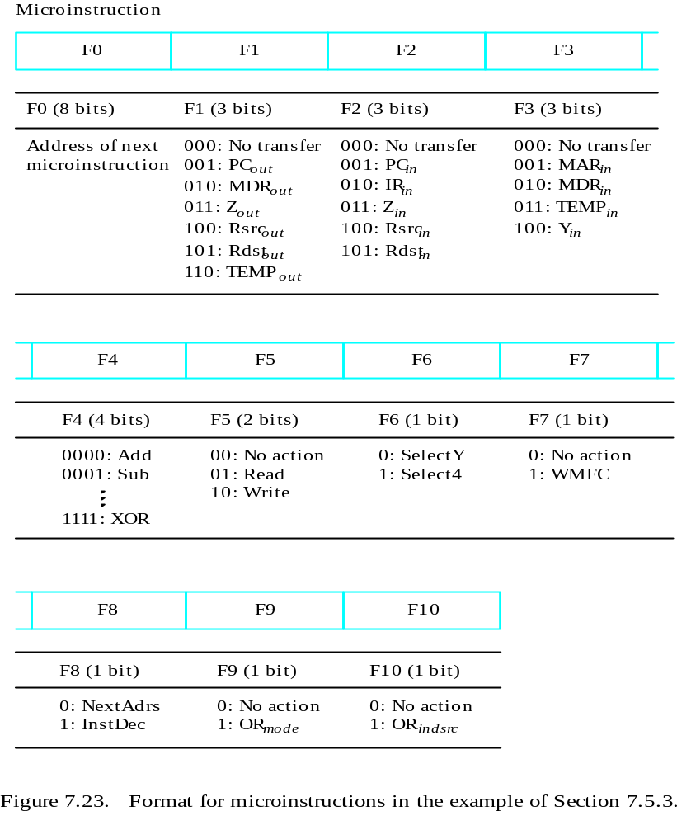

Slide 66
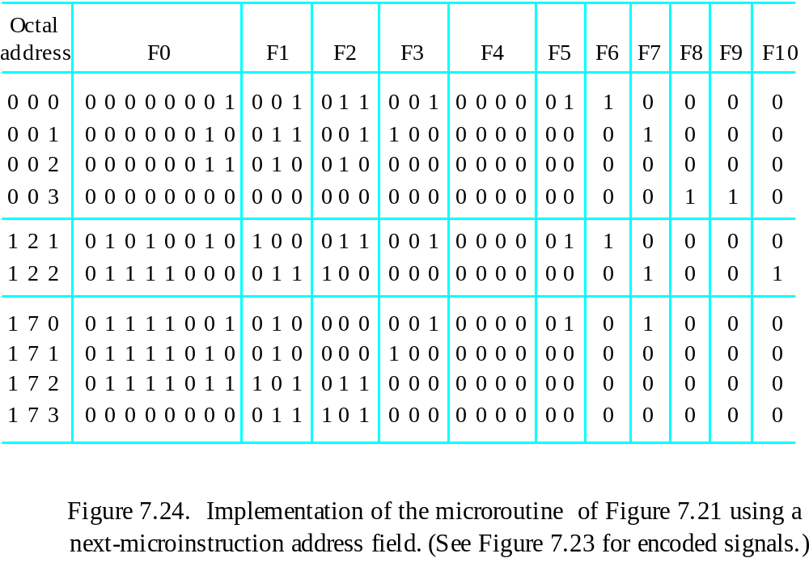
Implementation of the Microroutine

Slide 67
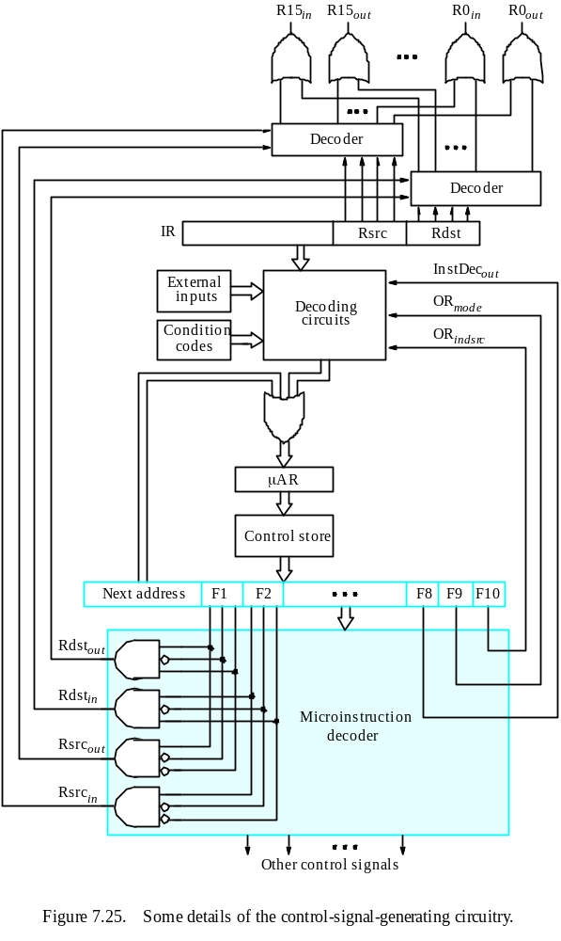

Slide 68
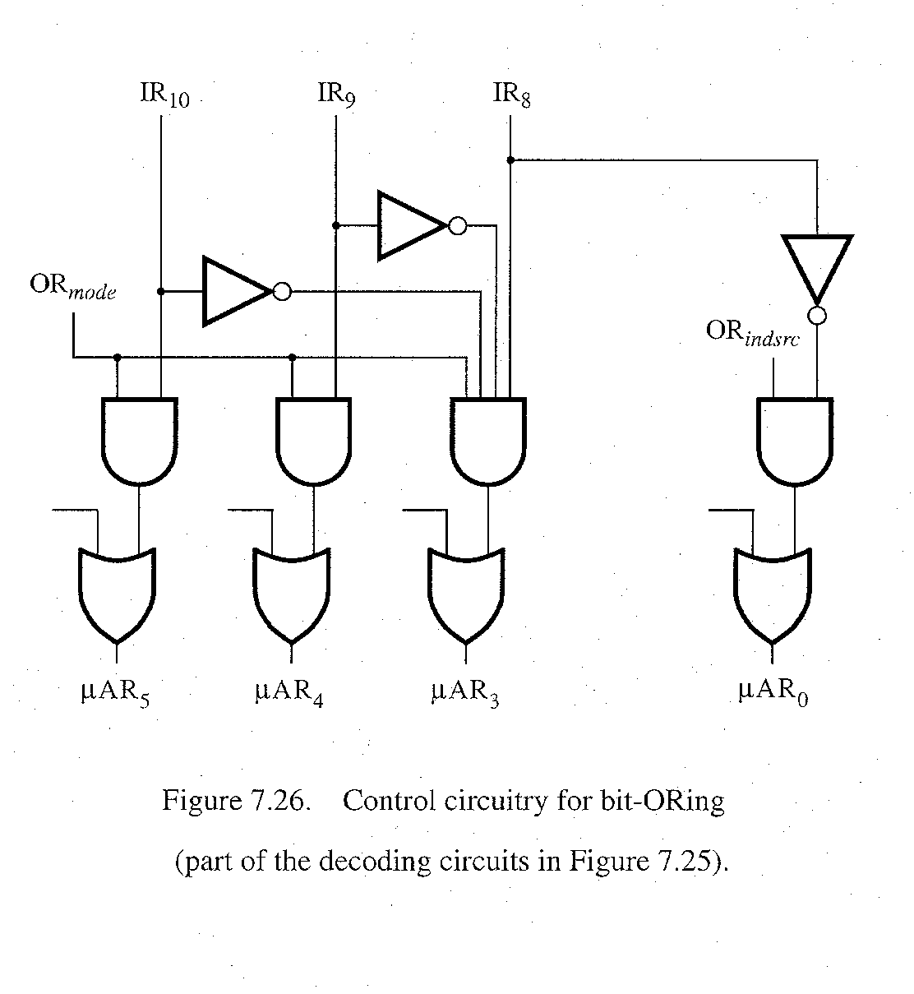
bit-ORing

Slide 69
Further Discussions
Prefetching
Emulation

